Slide 1
Parabolic Partial Differential Equations
by
Dr. Md. Rajibul Islam
CSE, UAP
http://numericalmethods.eng.usf.edu

Slide 2
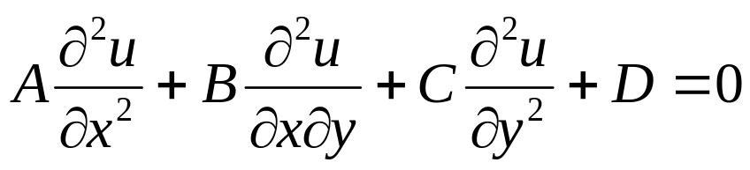

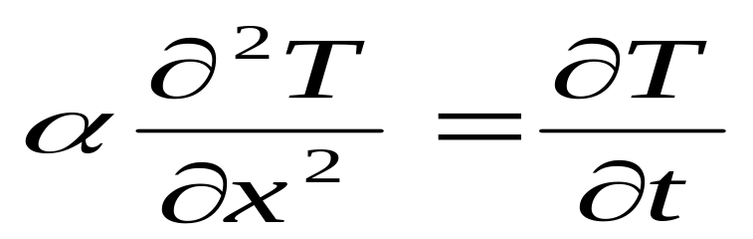

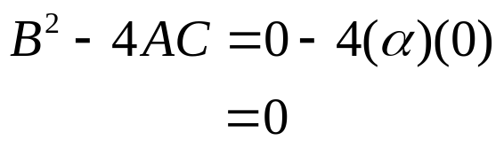
Defining Parabolic PDE’s
The general form for a second order linear PDE with two independent variables and one dependent variable is
Recall the criteria for an equation of this type to be considered parabolic
For example, examine the heat-conduction equation given by
Then
thus allowing us to classify this equation as parabolic.
, where

Slide 3
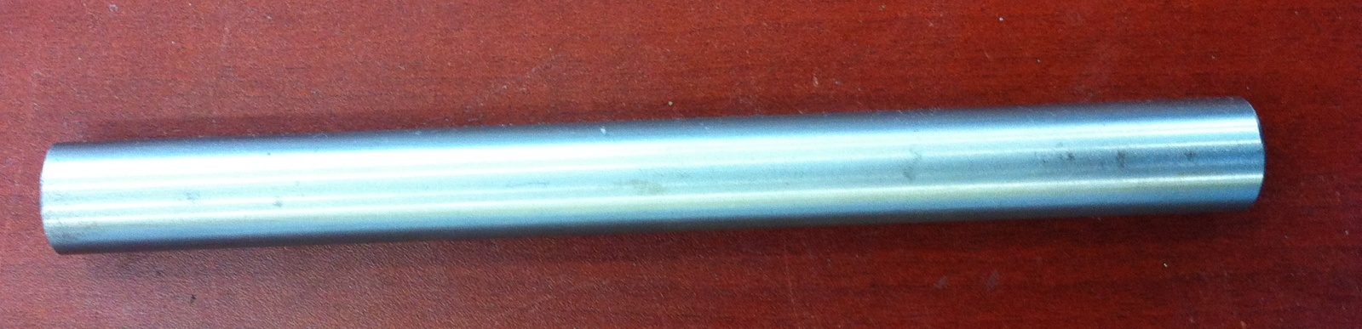
Physical Example of an Elliptic PDE
The internal temperature of a metal rod exposed to two different temperatures at each end can be found using the heat conduction equation.

Slide 4





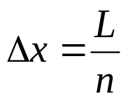





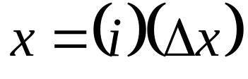
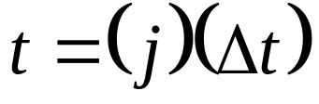
Discretizing the Parabolic PDE
Schematic diagram showing interior nodes
For a rod of length divided into nodes
The time is similarly broken into time steps of
Hence corresponds to the temperature at node ,that is,
and time

Slide 5
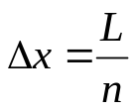
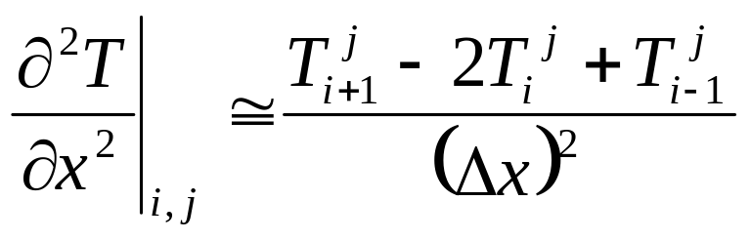

The Explicit Method
If we define we can then write the finite central divided difference
approximation of the left hand side at a general interior node ( ) as
where ( ) is the node number along the time.

Slide 6
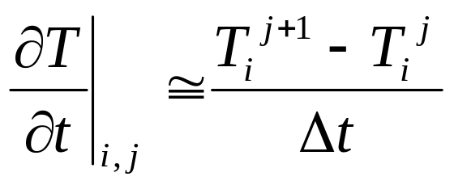
The Explicit Method
The time derivative on the right hand side is approximated by the forward divided difference method as,

Slide 7
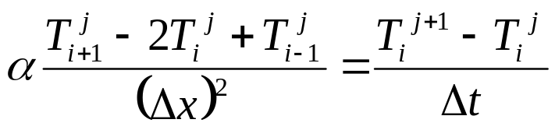

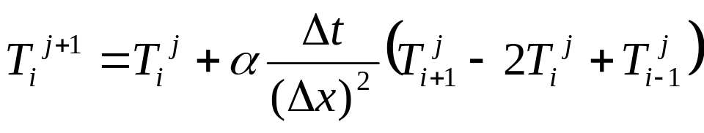
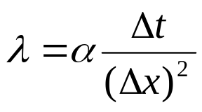
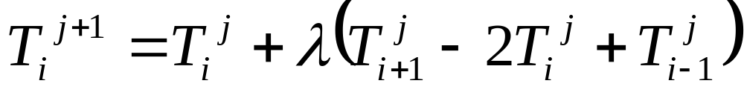
The Explicit Method
Substituting these approximations into the governing equation yields
Solving for the temp at the time node gives
choosing,
we can write the equation as,
.

Slide 8





The Explicit Method
This equation can be solved explicitly because it can be written for each internal location node of the rod for time node in terms of the temperature at time node .
In other words, if we know the temperature at node , and the boundary temperatures, we can find the temperature at the next time step.
We continue the process by first finding the temperature at all nodes , and using these to find the temperature at the next time node, . This process continues until we reach the time at which we are interested in finding the temperature.

Slide 9







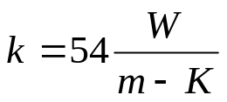
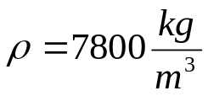
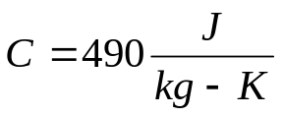










Example 1: Explicit Method
Consider a steel rod that is subjected to a temperature of on the left end and on the right end. If the rod is of length ,use the explicit method to find the temperature distribution in the rod from and seconds. Use , .
Given: , ,
The initial temperature of the rod is .

Slide 10
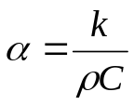
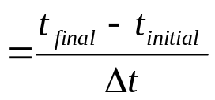
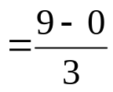
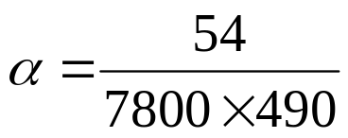


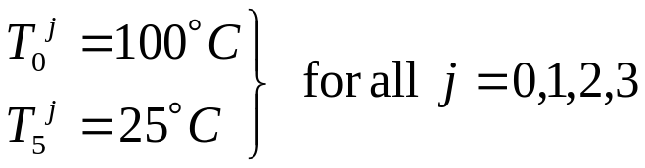
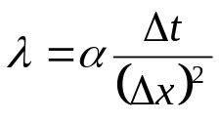
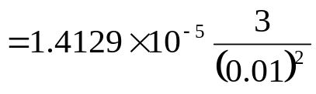



Example 1: Explicit Method
Recall,
therefore,
Then,
Number of time steps,
Boundary Conditions
All internal nodes are at
for This can be represented as,
.
.
.
.

Slide 11

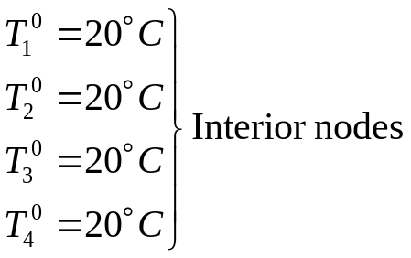

Example 1: Explicit Method
Nodal temperatures when , :
We can now calculate the temperature at each node explicitly using the equation formulated earlier,

Slide 12





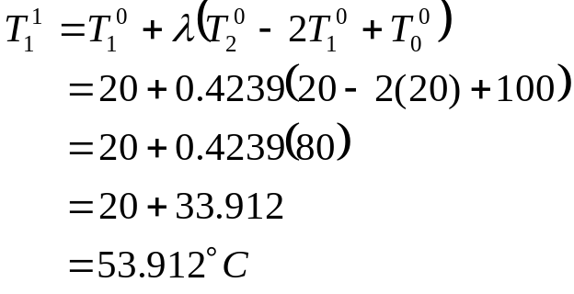

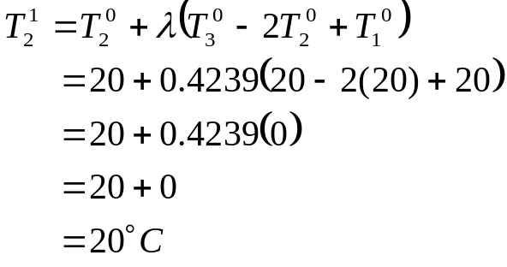


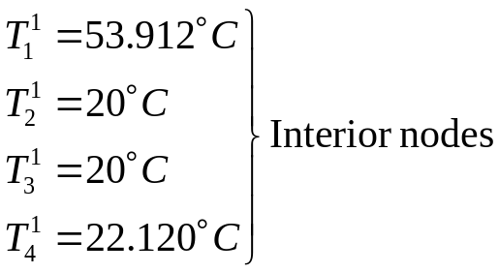

Example 1: Explicit Method
Nodal temperatures when (Example Calculations)
setting
Nodal temperatures when , :

Slide 13



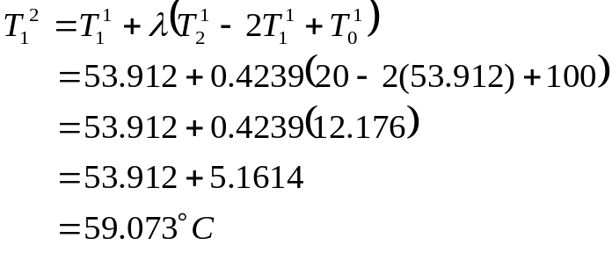
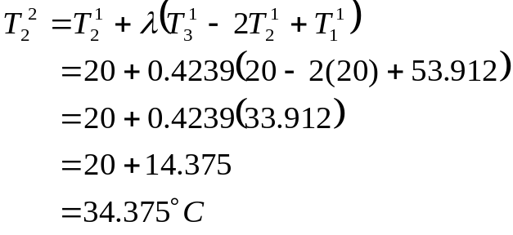


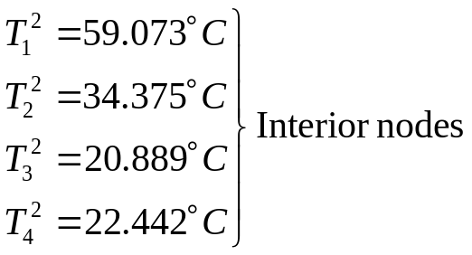

Example 1: Explicit Method
Nodal temperatures when (Example Calculations)
setting ,
Nodal temperatures when , :

Slide 14


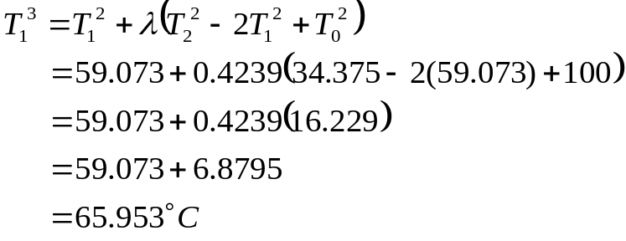
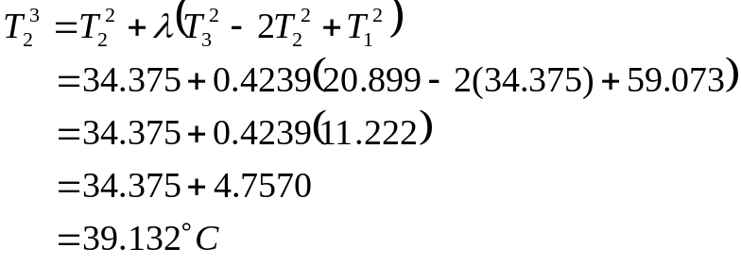


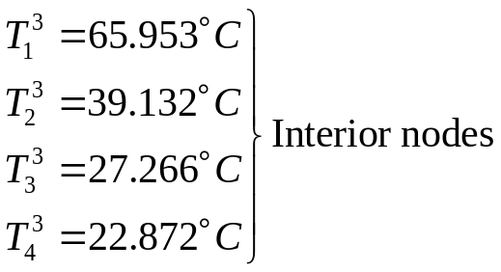

Example 1: Explicit Method
Nodal temperatures when (Example Calculations)
setting ,
Nodal temperatures when , :

Slide 15
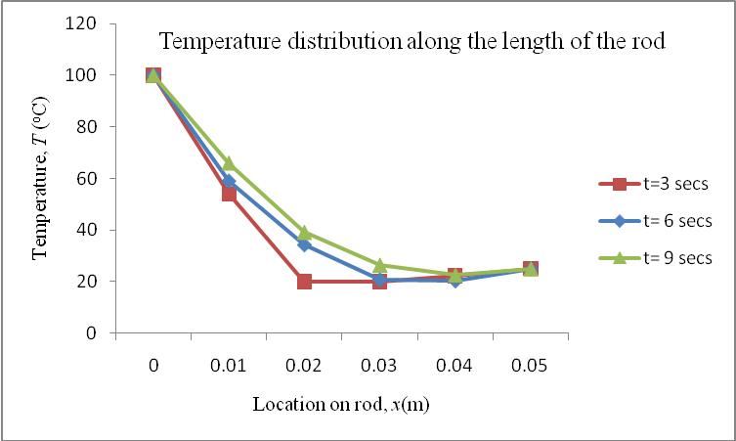
Example 1: Explicit Method
To better visualize the temperature variation at different locations at different times, the temperature distribution along the length of the rod at different times is plotted below.

Slide 16
The Implicit Method
WHY:
Using the explicit method, we were able to find the temperature at each node, one equation at a time.
However, the temperature at a specific node was only dependent on the temperature of the neighboring nodes from the previous time step. This is contrary to what we expect from the physical problem.
The implicit method allows us to solve this and other problems by developing a system of simultaneous linear equations for the temperature at all interior nodes at a particular time.

Slide 17


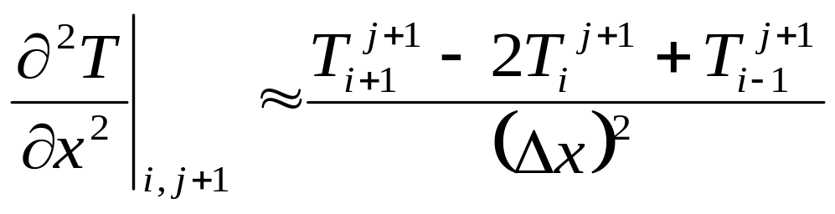
The Implicit Method
The second derivative on the left hand side of the equation is approximated by the CDD scheme at time level at node ( ) as

Slide 18
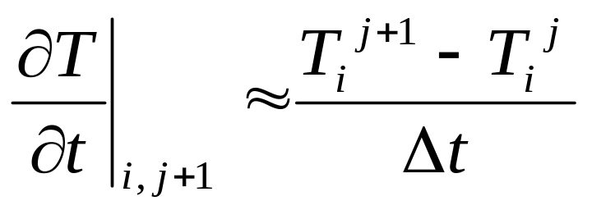
The Implicit Method
The first derivative on the right hand side of the equation is approximated by the BDD scheme at time level at node ( ) as

Slide 19
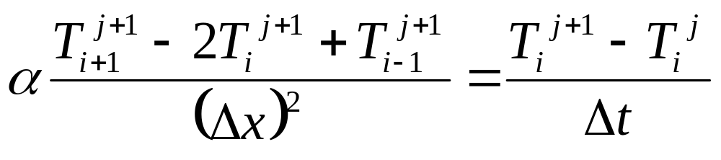
The Implicit Method
Substituting these approximations into the heat conduction equation yields

Slide 20
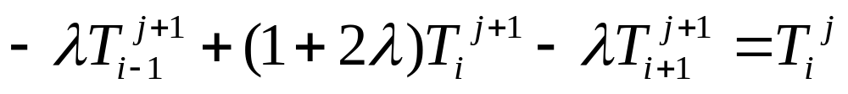

The Implicit Method
From the previous slide,
Rearranging yields
given that,
The rearranged equation can be written for every node during each time step. These equations can then be solved as a simultaneous system of linear equations to find the nodal temperatures at a particular time.

Slide 21
Example 2: Implicit Method
Consider a steel rod that is subjected to a temperature of on the left end and on the right end. If the rod is of length ,use the implicit method to find the temperature distribution in the rod from and seconds. Use , .
Given: , ,
The initial temperature of the rod is .

Slide 22
Example 2: Implicit Method
Recall,
therefore,
Then,
Number of time steps,
Boundary Conditions
All internal nodes are at
for This can be represented as,
.
.
.
.

Slide 23

Example 2: Implicit Method
Nodal temperatures when , :
We can now form our system of equations for the first time step by writing the approximated heat conduction equation for each node.

Slide 24


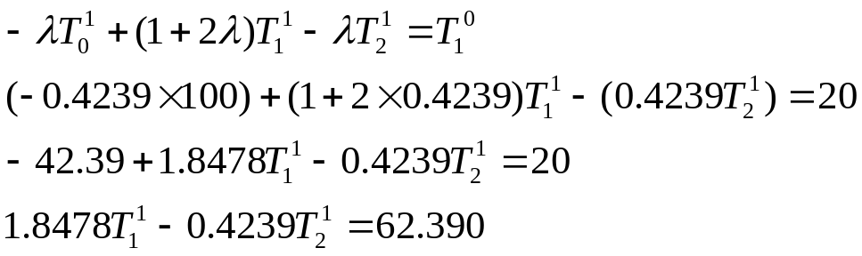

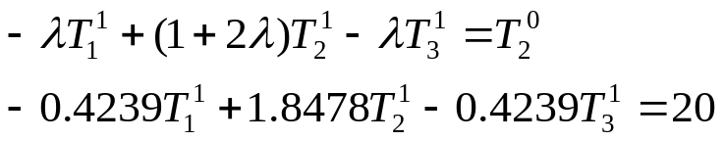
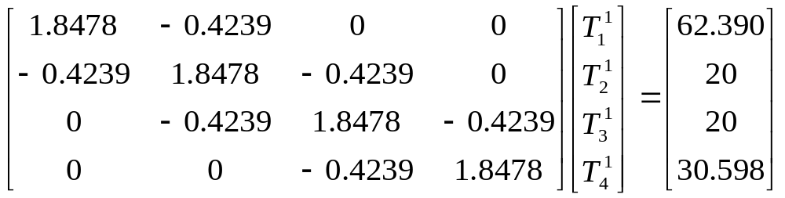
Example 2: Implicit Method
Nodal temperatures when , (Example Calculations)
For the interior nodes setting and gives the following,
For the first time step we can write four such equations with four unknowns, expressing them in matrix form yields

Slide 25
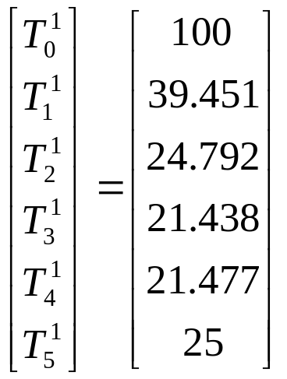
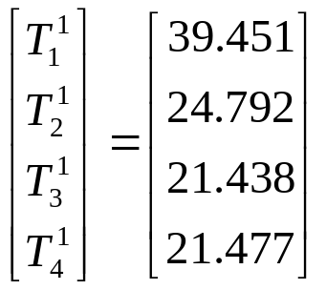
Example 2: Implicit Method
The above coefficient matrix is tri-diagonal. Special algorithms such as Thomas’ algorithm can be used to solve simultaneous linear equation with tri-diagonal coefficient matrices. The solution is given by
Hence, the nodal temps at are

Slide 26

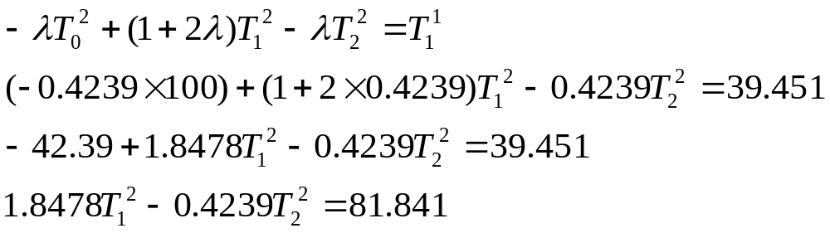
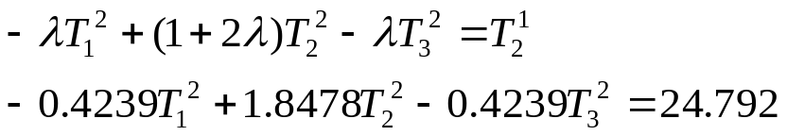
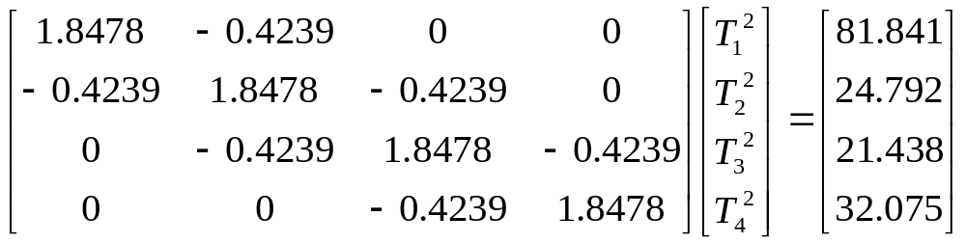
Example 2: Implicit Method
Nodal temperatures when , (Example Calculations)
For the interior nodes setting and gives the following,
For the second time step we can write four such equations with four unknowns, expressing them in matrix form yields

Slide 27
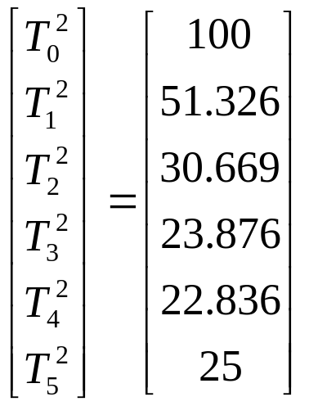
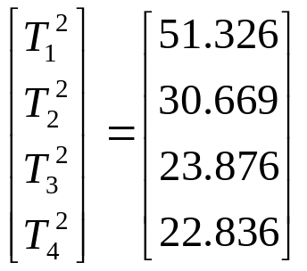

Example 2: Implicit Method
The above coefficient matrix is tri-diagonal. Special algorithms such as Thomas’ algorithm can be used to solve simultaneous linear equation with tri-diagonal coefficient matrices. The solution is given by
Hence, the nodal temps at are

Slide 28



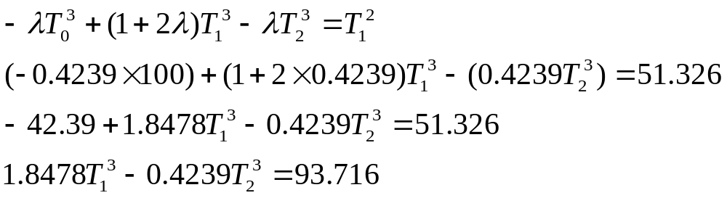


Example 2: Implicit Method
Nodal temperatures when , (Example Calculations)
For the interior nodes setting and gives the following,
For the third time step we can write four such equations with four unknowns, expressing them in matrix form yields

Slide 29



Example 2: Implicit Method
The above coefficient matrix is tri-diagonal. Special algorithms such as Thomas’ algorithm can be used to solve simultaneous linear equation with tri-diagonal coefficient matrices. The solution is given by
Hence, the nodal temps at are

Slide 30

Example 2: Implicit Method
To better visualize the temperature variation at different locations at different times, the temperature distribution along the length of the rod at different times is plotted below.

Slide 31




The Crank-Nicolson Method
WHY:
Using the implicit method our approximation of was of accuracy, while our approximation of was of accuracy.

Slide 32

The Crank-Nicolson Method
One can achieve similar orders of accuracy by approximating the second derivative, on the left hand side of the heat equation, at the midpoint of the time step. Doing so yields

Slide 33


The Crank-Nicolson Method
The first derivative, on the right hand side of the heat equation, is approximated using the forward divided difference method at time level ,

Slide 34


The Crank-Nicolson Method
Substituting these approximations into the governing equation for heat conductance yields
giving
where
Having rewritten the equation in this form allows us to descritize the physical problem. We then solve a system of simultaneous linear equations to find the temperature at every node at any point in time.

Slide 35
Example 3: Crank-Nicolson
Consider a steel rod that is subjected to a temperature of on the left end and on the right end. If the rod is of length ,use the Crank-Nicolson method to find the temperature distribution in the rod from to seconds. Use , .
Given: , ,
The initial temperature of the rod is .

Slide 36
Example 3: Crank-Nicolson
Recall,
therefore,
Then,
Number of time steps,
Boundary Conditions
All internal nodes are at
for This can be represented as,
.
.
.
.

Slide 37
Example 3: Crank-Nicolson
Nodal temperatures when , :
We can now form our system of equations for the first time step by writing the approximated heat conduction equation for each node.

Slide 38



Example 3: Crank-Nicolson
Nodal temperatures when , (Example Calculations)
For the interior nodes setting and gives the following
For the first time step we can write four such equations with four unknowns, expressing them in matrix form yields

Slide 39


Example 3: Crank-Nicolson
The above coefficient matrix is tri-diagonal. Special algorithms such as Thomas’ algorithm can be used to solve simultaneous linear equation with tri-diagonal coefficient matrices. The solution is given by
Hence, the nodal temps at are

Slide 40





Example 3: Crank-Nicolson
Nodal temperatures when , (Example Calculations)
For the interior nodes setting and gives the following,
For the second time step we can write four such equations with four unknowns, expressing them in matrix form yields

Slide 41


Example 3: Crank-Nicolson
The above coefficient matrix is tri-diagonal. Special algorithms such as Thomas’ algorithm can be used to solve simultaneous linear equation with tri-diagonal coefficient matrices. The solution is given by
Hence, the nodal temps at are

Slide 42



Example 3: Crank-Nicolson
Nodal temperatures when , (Example Calculations)
For the interior nodes setting and gives the following,
For the third time step we can write four such equations with four unknowns, expressing them in matrix form yields

Slide 43


Example 3: Crank-Nicolson
The above coefficient matrix is tri-diagonal. Special algorithms such as Thomas’ algorithm can be used to solve simultaneous linear equation with tri-diagonal coefficient matrices. The solution is given by
Hence, the nodal temps at are

Slide 44

Example 3: Crank-Nicolson
To better visualize the temperature variation at different locations at different times, the temperature distribution along the length of the rod at different times is plotted below.

Slide 45





Internal Temperatures at 9 sec.
The table below allows you to compare the results from all three methods discussed in juxtaposition with the analytical solution.
Node | Explicit | Implicit | Crank-Nicolson | Analytical

Slide 46
THE END

